Slide 1
Introduction
A machine learning model’s performance is evaluated based on how accurate is its prediction and how well it generalizes on another independent dataset it has not seen.
The errors in a machine learning model can be broken down into 3: 1. Irreducible Error 2. Bias Error
3. Variance Error

Slide 2


What is Bias?
Introduction
Bias is basically how far we have predicted the values from actual values.

Slide 3

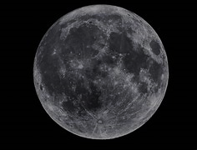
What is variance?
Introduction
Variance is basically how scattered the predicted values from actual values.

Slide 4
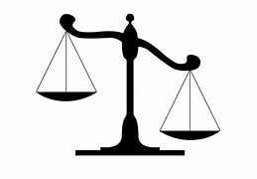
Introduction
Bias
Variance
Models that have high bias tend to have low variance. For example, linear regression models tend to have high bias and low variance.
Models that have low bias tend to have high variance. For example, complex non-linear models tend to have low bias with high variance.

Slide 5
Introduction
The Bias-Variance Tradeoff
The bias-variance tradeoff refers to the tradeoff that takes place when we choose to lower bias which typically increases variance, or lower variance which typically increases bias.

